Slide 1

Sentiment Analysis and Text Mining
Submitted By:
Arvind Neelakantan
Avi Jain
Dwij Dua
Parthavi Madaan

Slide 2
Goal of the project
Building a Predictive Model to analyze the Sentiments of customers on the Mobile-Phones sold by Amazon.
Our Approach:
Feature Extraction: Term Frequency – Inverse Document Frequency Approach
Classification: Logistic regression

Slide 3
Dataset
The dataset used is an Amazon Mobile Reviews dataset
Amazon Reviews: Unlocked Mobile Phones | Kaggle
Number of records – 400000
Entities – Product Name, Brand Name, Price, Rating, Reviews and Review Votes.

Slide 4

Approach
Dataset Overview:
EDA and Data Visualization
Data Pre-processing:
Text Normalization
Vectorization
Text Representation
Sentiment Model
ML Model for Prediction

Slide 5
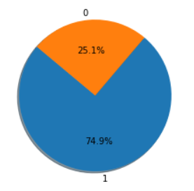
Dataset Overview
EDA:
Loaded random 5% sample from our raw data into a Dataframe.
Basic descriptive statistics.
Creating new derived variable ‘Sentiment’ from ratings column.
Data Visualization:
Positive Sentiment (1) vs Negative Sentiment (0)
Almost 75% of the reviews taken at random showed
positive sentiment.

Slide 6
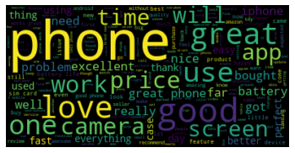
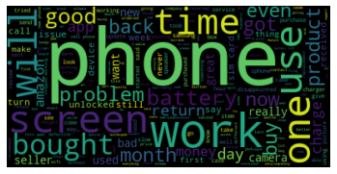
Dataset Overview
Dataset Visualization:
Word cloud: Finding most commonly used words
Positive Sentiment | Negative Sentiment

Slide 7
Data Pre-processing:
Text Normalization:
Word Features
Removing upper capitalization
Word Repetition
Punctuation Repetition
Word Contraction
Tokenization
Remove English punctuation signs using string package
Create a set of Stop-words
Build a custom_tokenizer function

Slide 8
Data Pre-processing:
Text Normalization:
Stemming:
Build a stem_tokens function that takes the list of tokens as input and returns a list of stemmed tokens.
Lemmatization
Creating the lemmatizer by using the WordNet module.
Combining all Text normalization functions together
Building a function which combines functions from previous modules.

Slide 9
Vectorization
Text representation:
Representing text numerically allows it to be understood by ML models.
Explored below techniques for representing text:
Negative /Positive
Bag of Words
TF IDF
We decided to use the TF IDF technique for vectorization.

Slide 10
Sentiment Model
Data frames X and Y were created, where X represented the token from the Reviews and Y represents the sentiment 1 or 0, i.e., Positive or Negative
Data split into Training and Test by 80-20 percent.
Created a Logistic Regression Model using training data.
Test data was analysed by the model to predict the sentiment, efficiency of the Logistic Regression Model is 92.69%

Slide 11
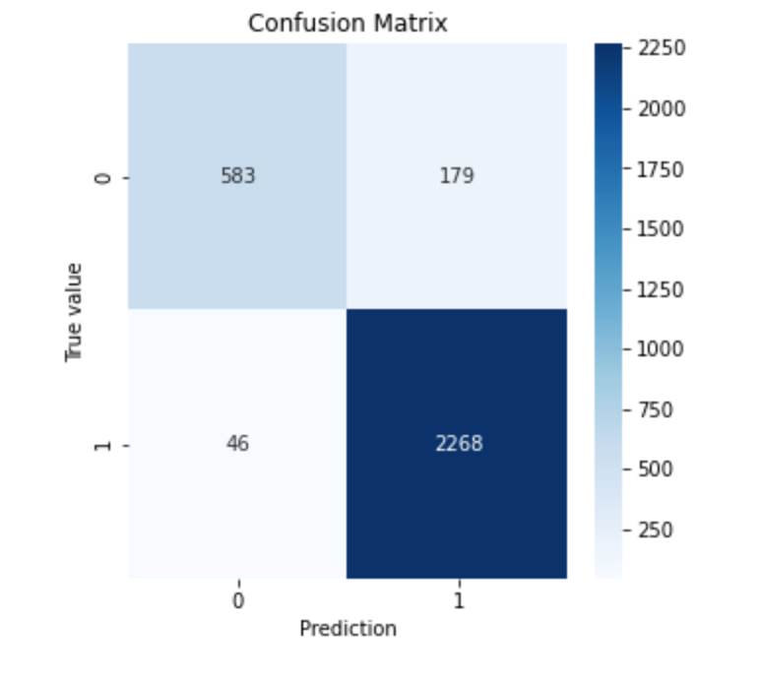
Graphs and Visualizations
The Confusion Matrix outlines the results of the Predicted vs the Actual sentiments.
True Positives - 2268
True Negatives - 583
False Positives - 179
False Negatives - 46
Accuracy = 2851/3076 = 92.68%

Slide 12
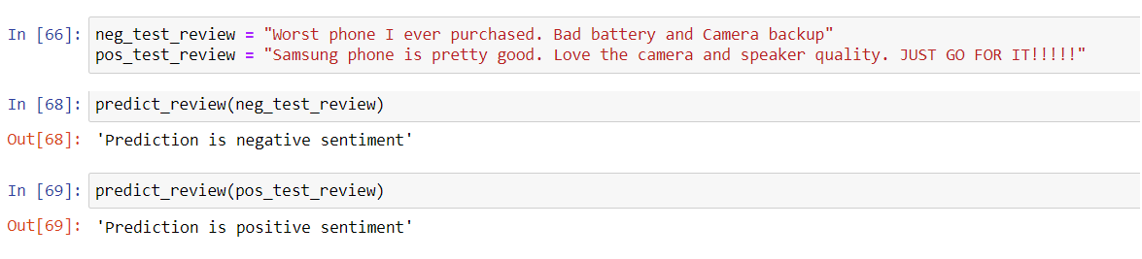
Pipeline
Created a predict_review function to pre-process, transform and predict review sentiment.

Slide 13
Results
Test data was analysed by the model to predict the sentiment, efficiency of the Logistic Regression Model is 92.69%
Positive and Negative sentiments are now being predicted for completely new phone reviews.

Slide 14
References
https://arxiv.org/pdf/1806.06407.pdf
https://towardsdatascience.com/another-twitter-sentiment-analysis-with-python-part-5-50b4e87d9bdd
https://datascience.stackexchange.com/questions/67215/using-tf-idf-for-feature-extraction-in-sentiment-analysis

